Slide 1

Project Title - Seasonal Agriculture Performance Analysis
Shiwank Singh
School of Management Sciences, Lucknow
AICTE STU ID :STU69d6286ddc3ff1775642733

Slide 2

PROBLEM STATEMENT
Agricultural activities are influenced by seasonal variations in environmental conditions, farming practices, resource availability and market conditions. As a result, agricultural performance may differ from one season to another. However, raw agricultural data does not clearly explain how agricultural performance changes across seasons or what patterns can be observed in different seasonal conditions. The problem is to analyze the given agricultural dataset and investigate seasonal differences in agricultural performance by identifying meaningful patterns, trends, relationships and variations within the available data.

Slide 3
Project Description
This project analyzes 4,000 agricultural records across Kharif, Rabi and Zaid seasons. It examines environmental conditions, resource usage, crop performance, water efficiency and economic outcomes using data cleaning, exploratory analysis, statistics and visualization to identify seasonal patterns and evidence-based recommendations.

Slide 4

WHO ARE THE END USERS?
• Farmers and farm managers
• Agricultural planners and decision-makers
• Researchers and agronomists
• Agricultural organizations and policymakers

Slide 5

Technology Used
Python
Jupyter Notebook
Pandas
NumPy
Matplotlib
Seaborn
Excel
Data Cleaning
EDA
Statistical Analysis
Data Visualization

Slide 6
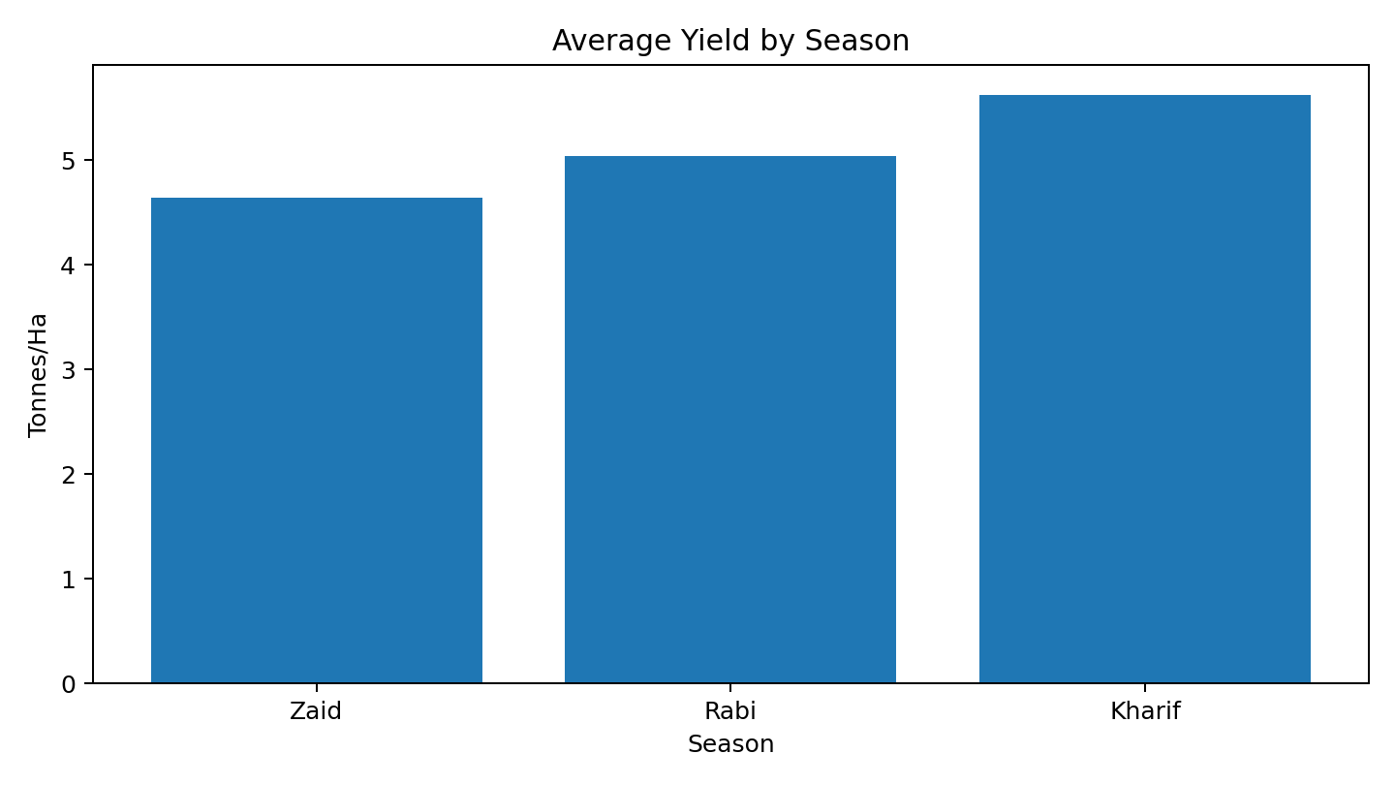
RESULTS
Seasonal Yield
Kharif: 5.64 t/ha | Rabi: 5.08 | Zaid: 4.67

Slide 7
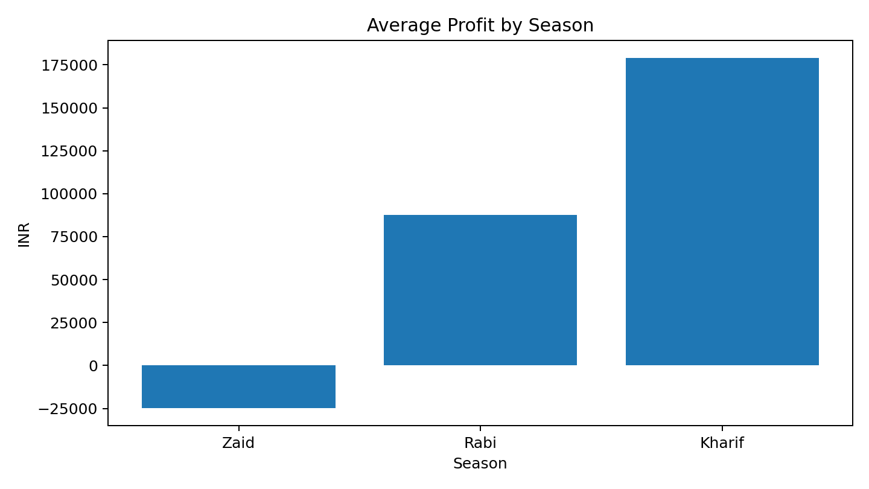
RESULTS
Seasonal Profit
Kharif: ₹178,915 | Rabi: ₹87,689 | Zaid: -₹24,805

Slide 8
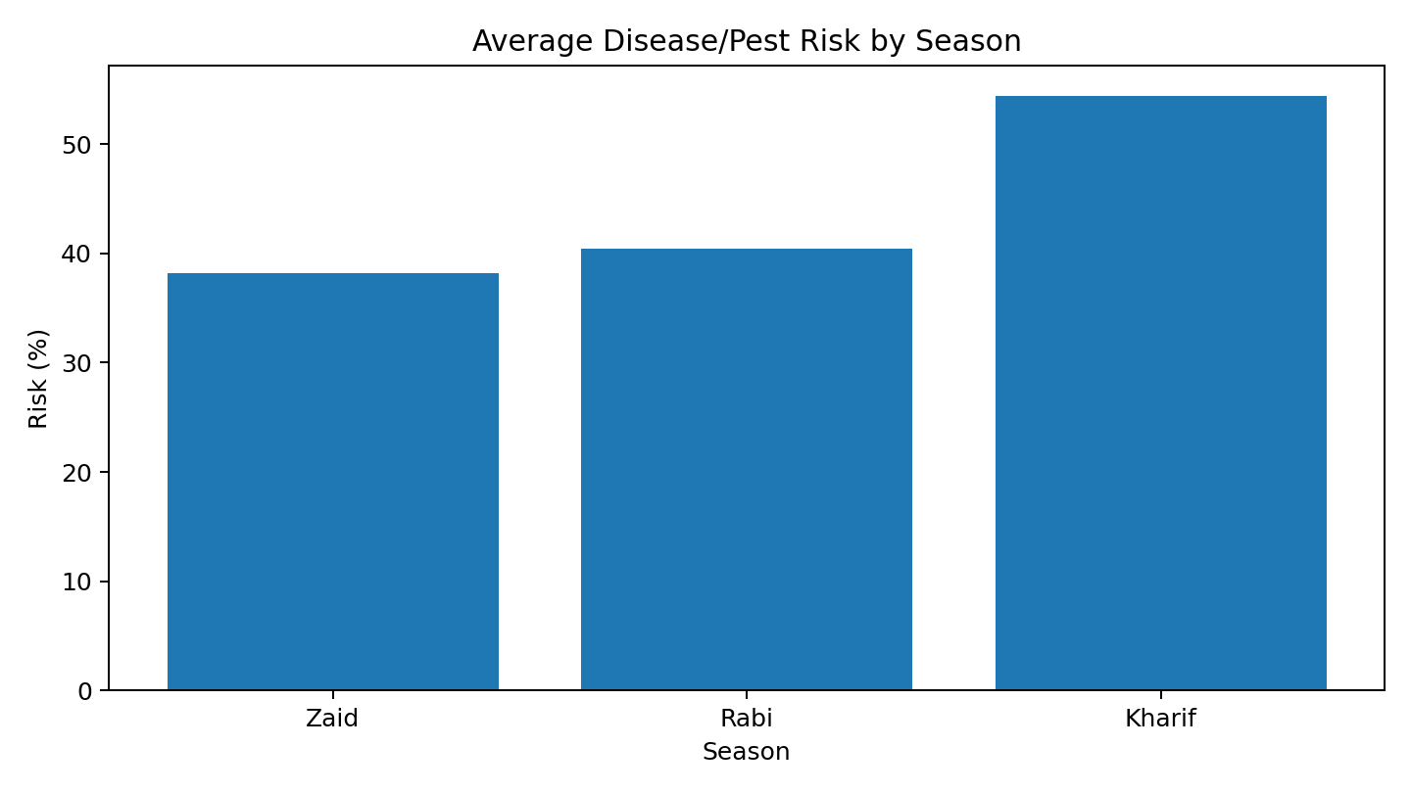
RESULTS
Risk Pattern
Average disease/pest risk: Kharif 54.5%, Rabi 40.5%, Zaid 38.2%

Slide 9
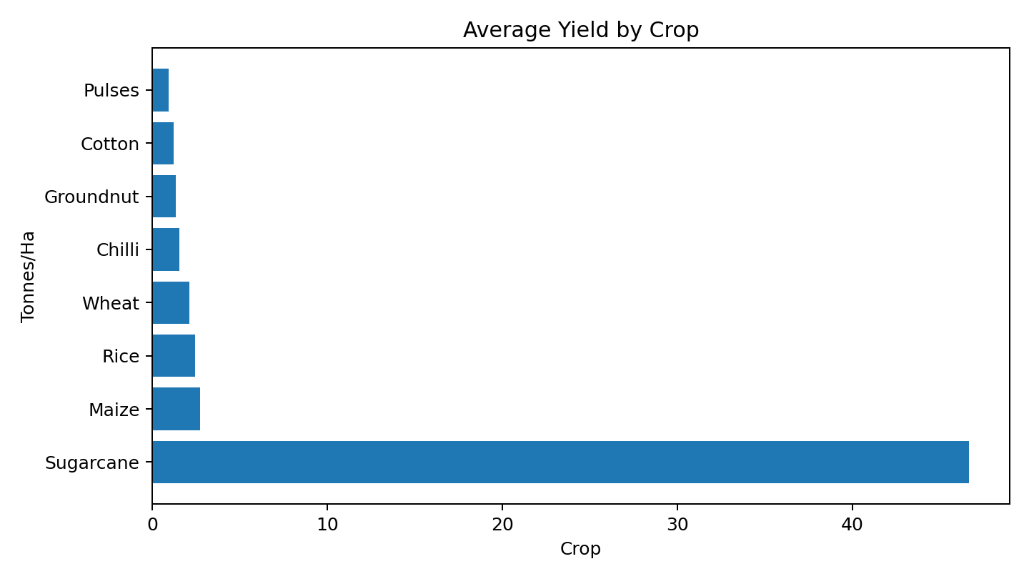
RESULTS
Crop Performance
Sugarcane has the highest average yield; crop type strongly affects performance.

Slide 10
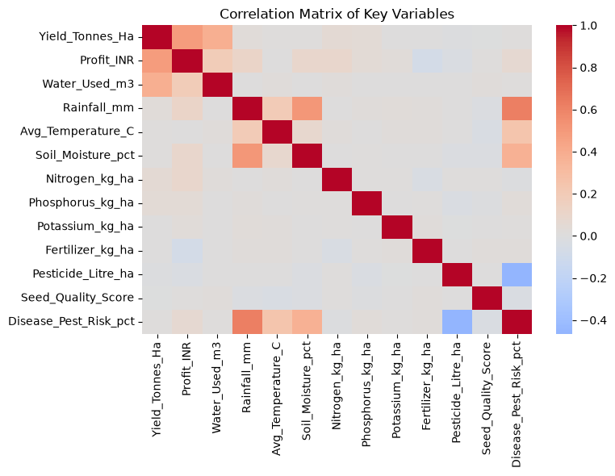
RESULTS
Correlation Matrix of Key Variables

Slide 11
Future scope
• Predictive models for yield and profit
• Time-series weather and market data
• Interactive agricultural dashboard
• More regions and crops
• Deeper resource-efficiency and sustainability analysis

Slide 12
Conclusion and Recommendations
Seasonal conditions are associated with meaningful differences in agricultural outcomes.
Kharif appears strongest on average across major performance measures in this dataset.
Water efficiency should be considered alongside yield and profit when evaluating farming performance.
Drip irrigation is associated with strong average yield and profit and merits further investigation.
Crop type is an important consideration because yield and profitability vary substantially across crops.
Future analysis could use predictive modelling, more detailed regional analysis, time-series data and weather/market data to improve planning.

Slide 13
GitHub Link
Seasonal-Agricultural-Analysis
Tap the link above

Slide 14

VOIS Course completion certificate -
Course name- Data Visualization

Slide 15
Thank you
.
.

